Slide 1
Student Journey Configurator Prototype: An application of Usability Engineering Concepts
By:
Shreya Bose
Krishna Vaghasiya
Fatemeh Moradian Tehrani
Sabit Shaikholla

Slide 2
Main aim of the project
Applying the principles of Usability Engineering
Explore some basic concepts of Usability Engineering such as Persuasive Design, Behavioral Level of Individualism (Usability Engineering with respect to Culture)
Implementing the different techniques such as Personas, User Stories, Use Case Diagram, Prototyping and Iterative Testing

Slide 3
Student Journey Configurator
The Student Journey Configurator is a platform in the framework of Managing the Digital Transformation – Digital Education Ecosystem (ManDEE).
It is aimed to support the students who are planning to start their studies in the EuroPIM (European Partnership for Project and Innovation Management) program, which is one of the largest university partnership consortiums in the sphere of project management. The platform is meant to provide easy-to-use access through which the prospective students could configure their studies in different aspects such as Specialization, Double Degree or their Work Experience.
The partner universities are from Bilbao (University of the Basque Country, UPV, Spain), Leuven (KU Leuven, Belgium), Kaunas (KTU Kaunas, Lithuania) and Trondheim (NTNU, Norway).

Slide 4
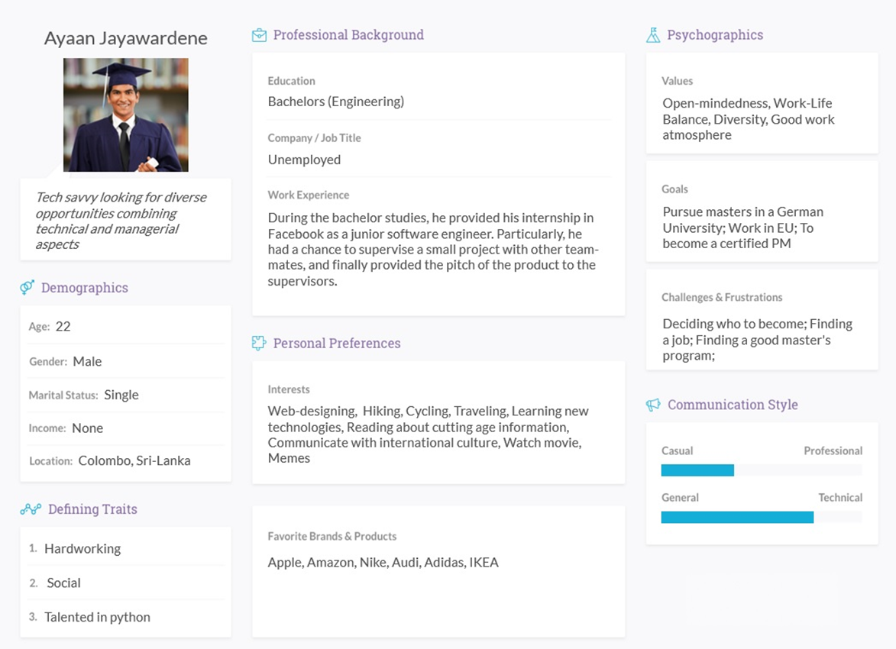
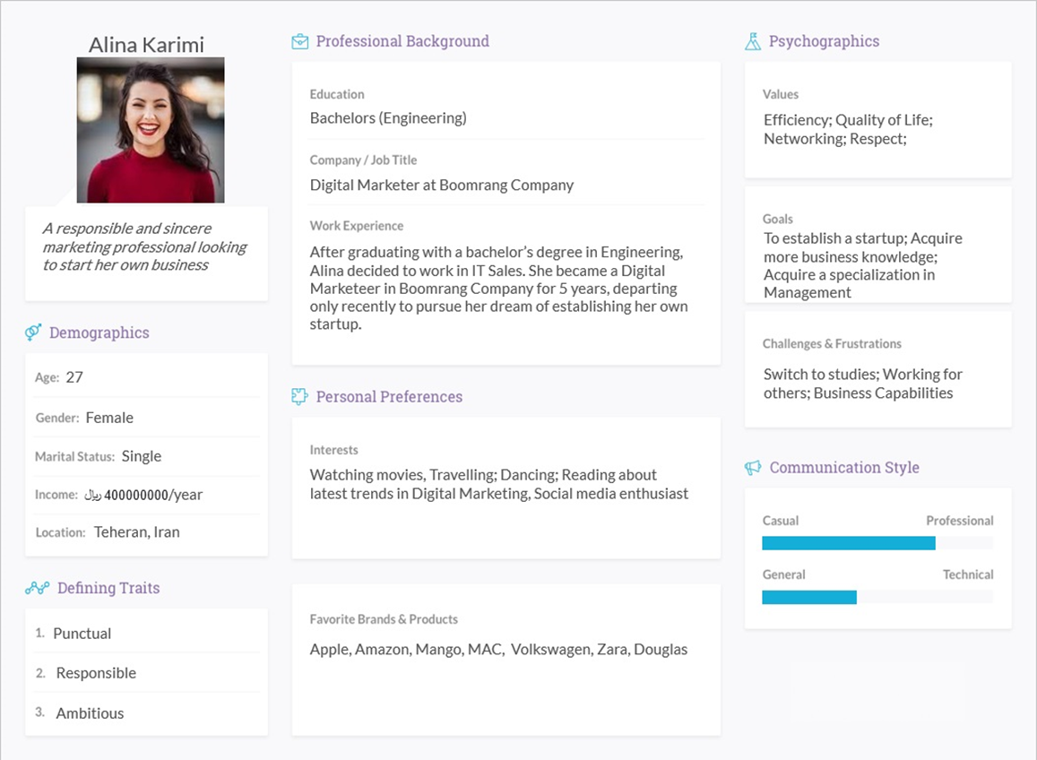
Persona

Slide 5
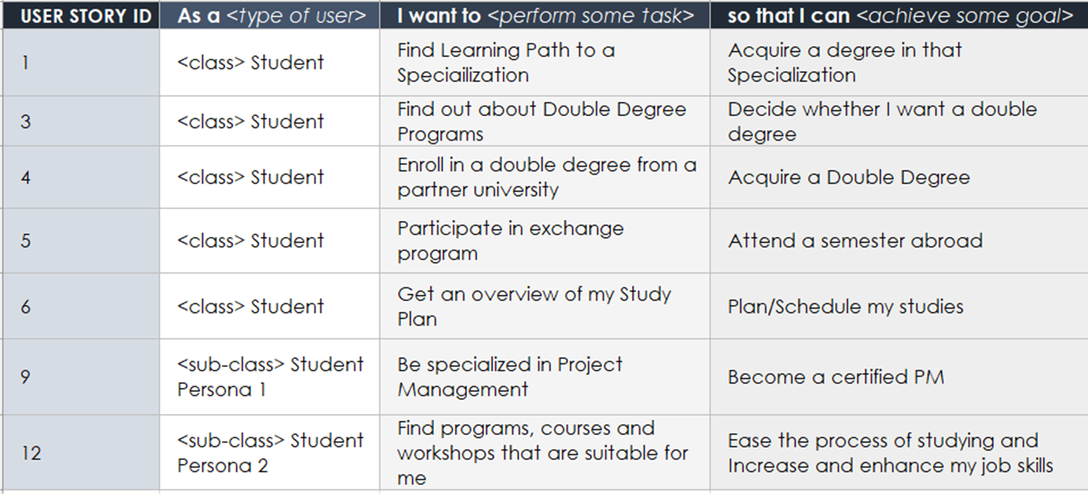
User Stories

Slide 6
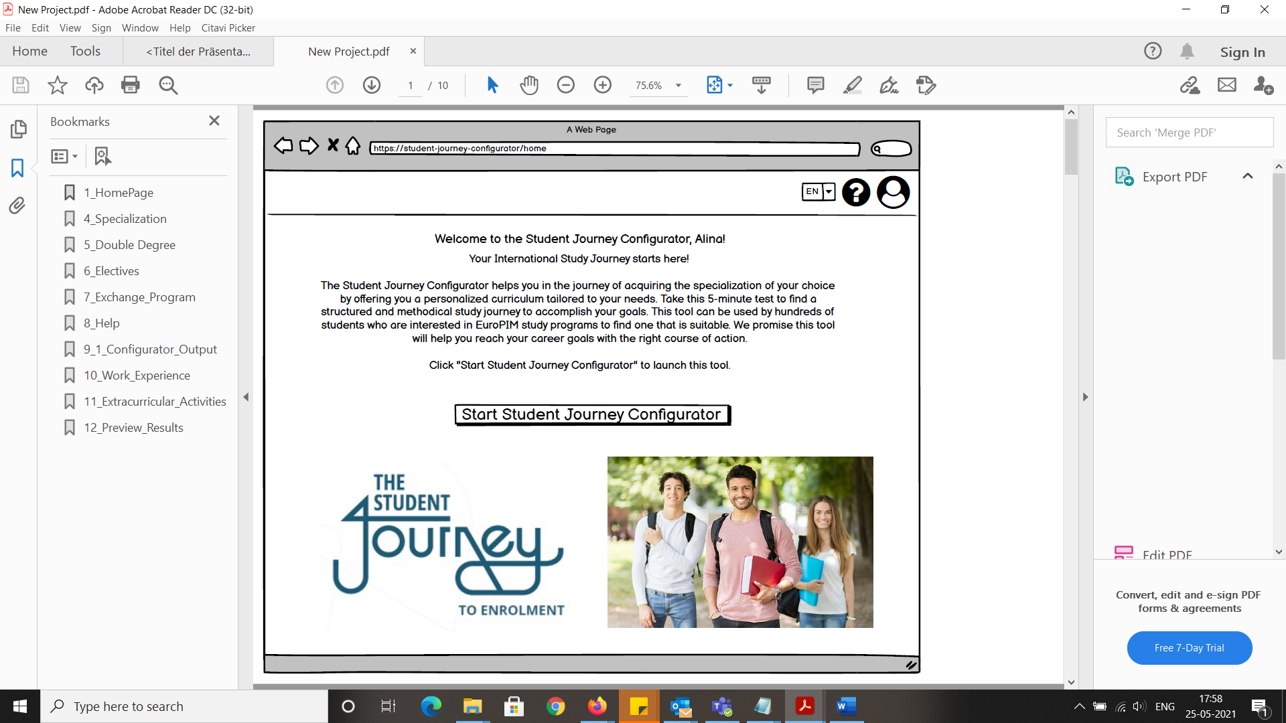
Student Journey Configurator Prototype: Home Page

Slide 7
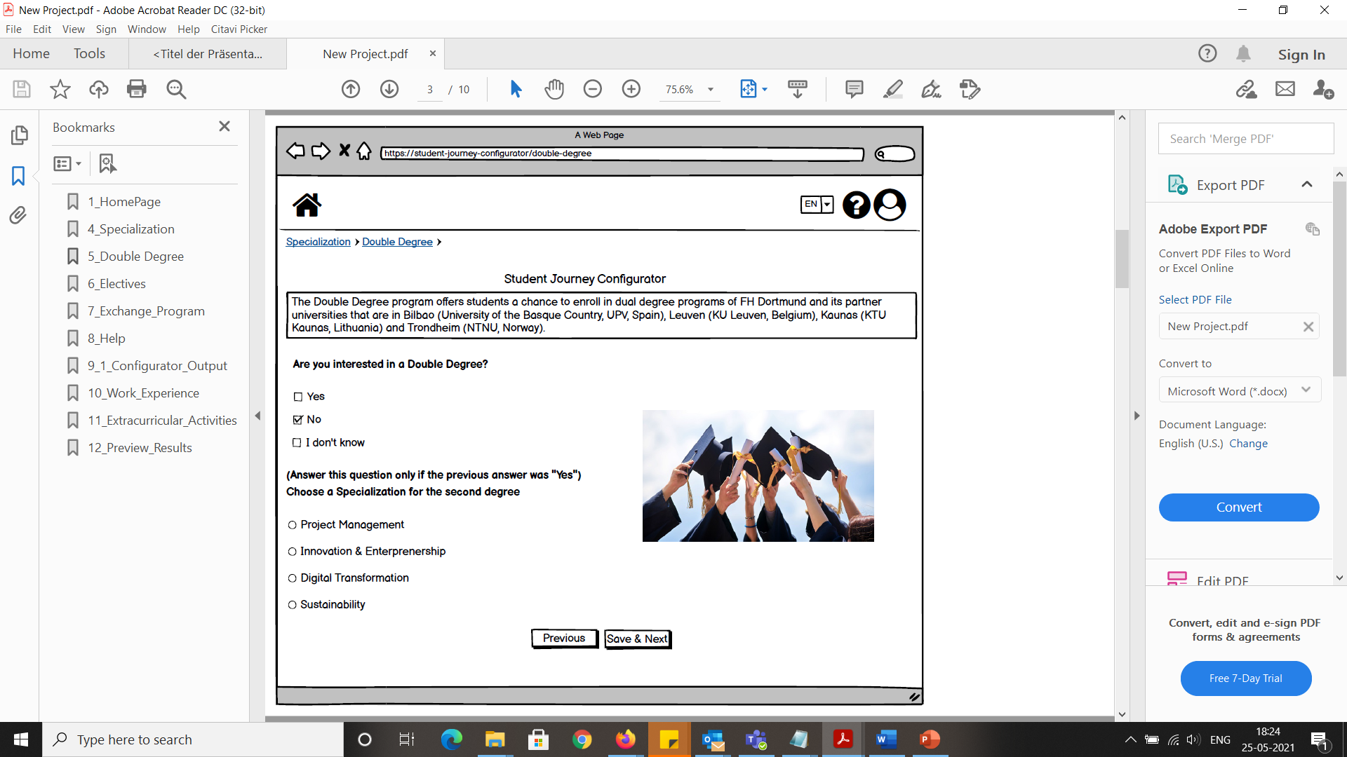
Student Journey Configurator Prototype: Double Degree Page

Slide 8
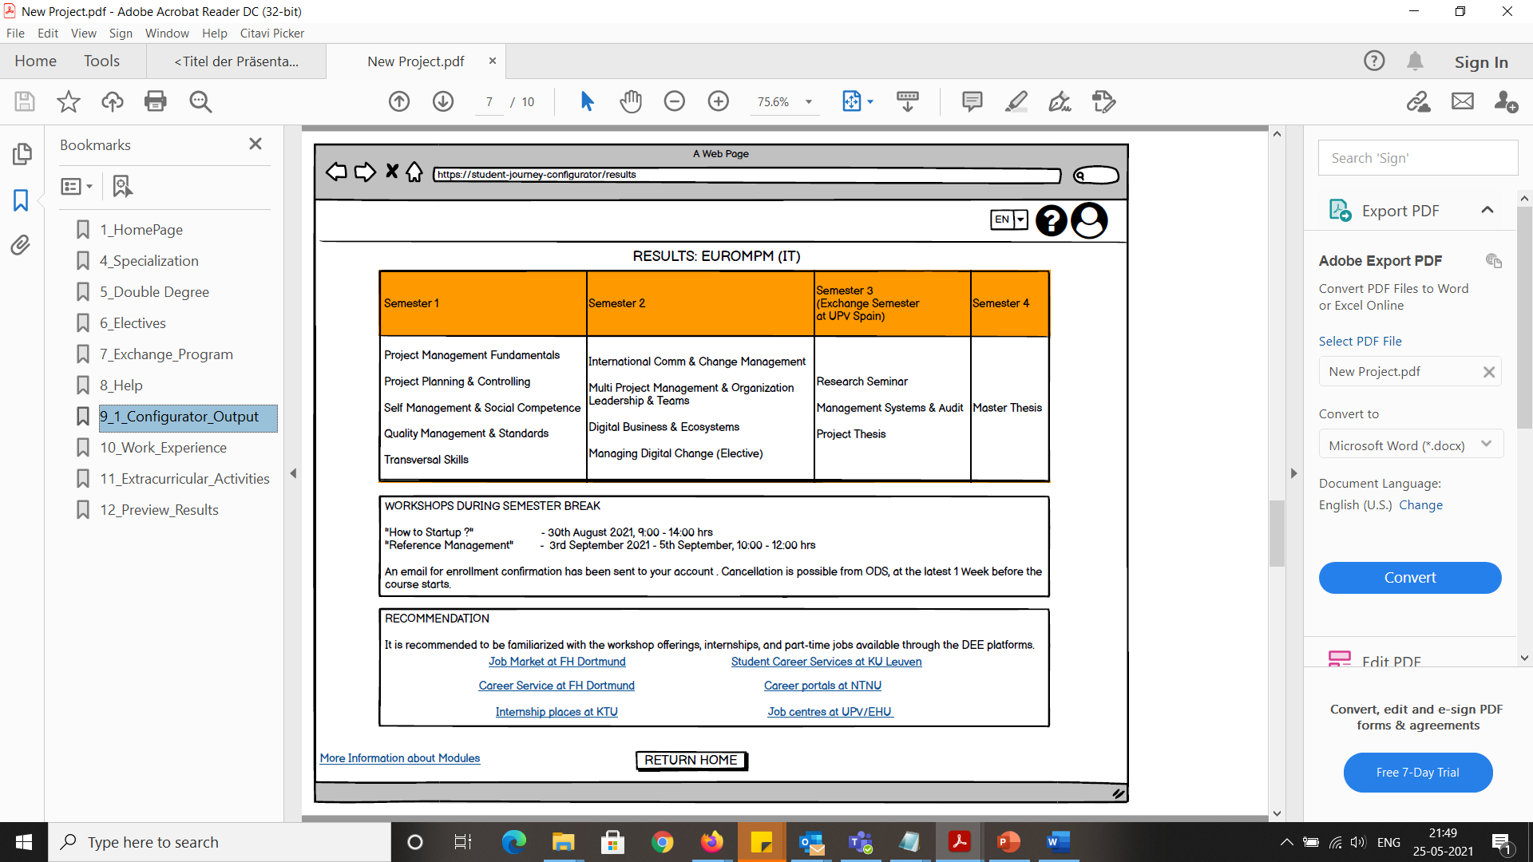
Student Journey Configurator Prototype: Results Page

Slide 9
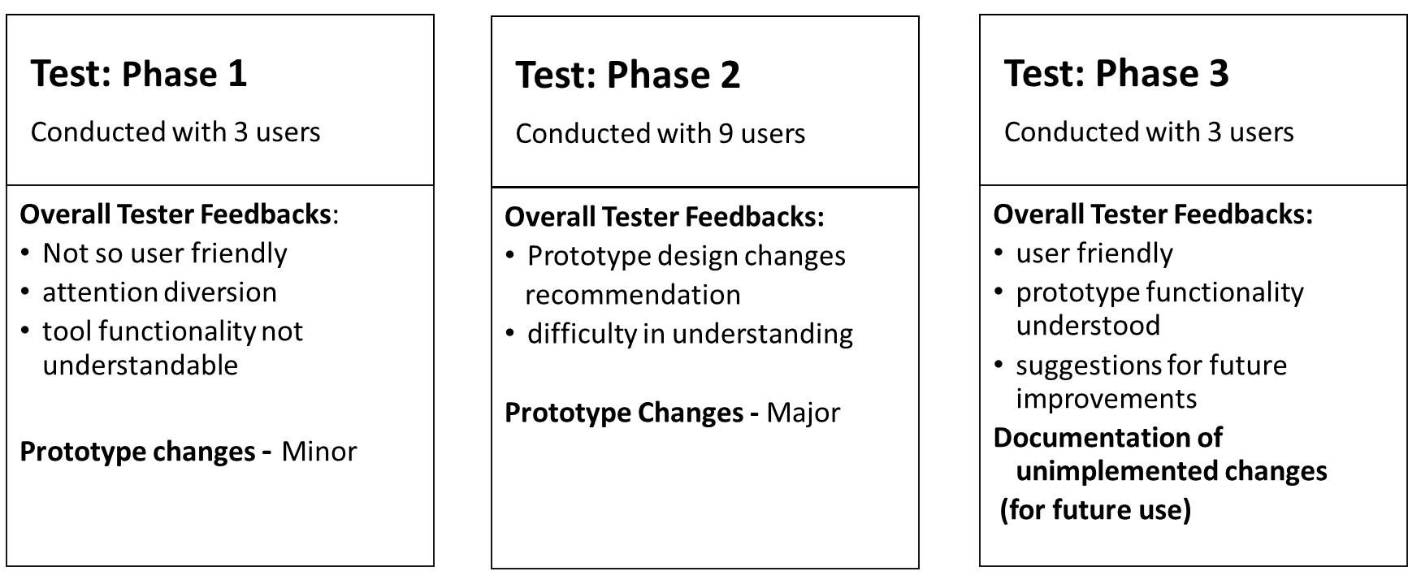
Iterative Testing

Slide 10
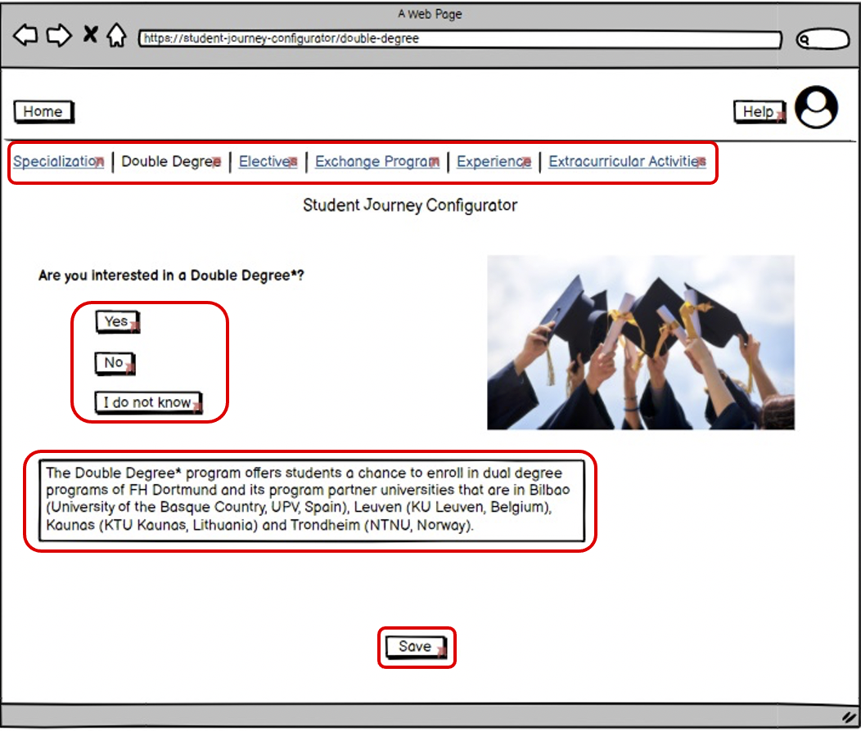
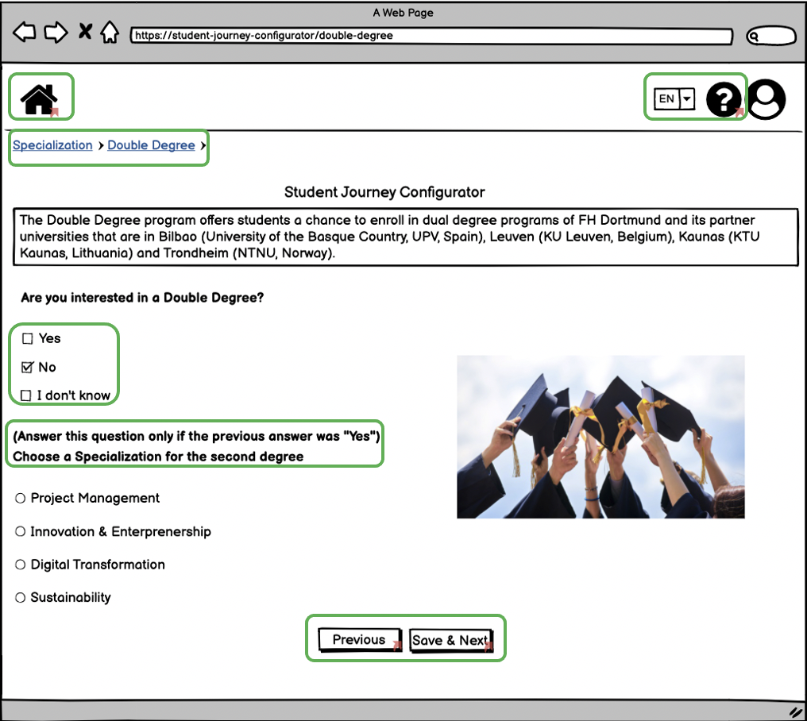
Iterative Testing: Before and After

Slide 11

Conclusion
Defined main types of users and their behavioral patterns using different tools and techniques
Documented the user feedback in the form of protocols and notes
The iterative approach for changes and improvements is taken as a backbone of the development
Developed a prototype of a Student Journey Configurator and provided the usability tests with derived group of users (focus group)
Attempted to reflect the main pinpoints of usability engineering while conducting and developing the prototype of the platform

Slide 12
Thank you!
You can find us:
shreya.bose001@stud.fh-dortmund.de
krishna.vaghasiya001@stud.fh-dortmund.de
sabit.shaikholla008@stud.fh-dortmund.de
fatemeh.moradiantehrani001@stud.fh-dortmund.de

